Slide 1

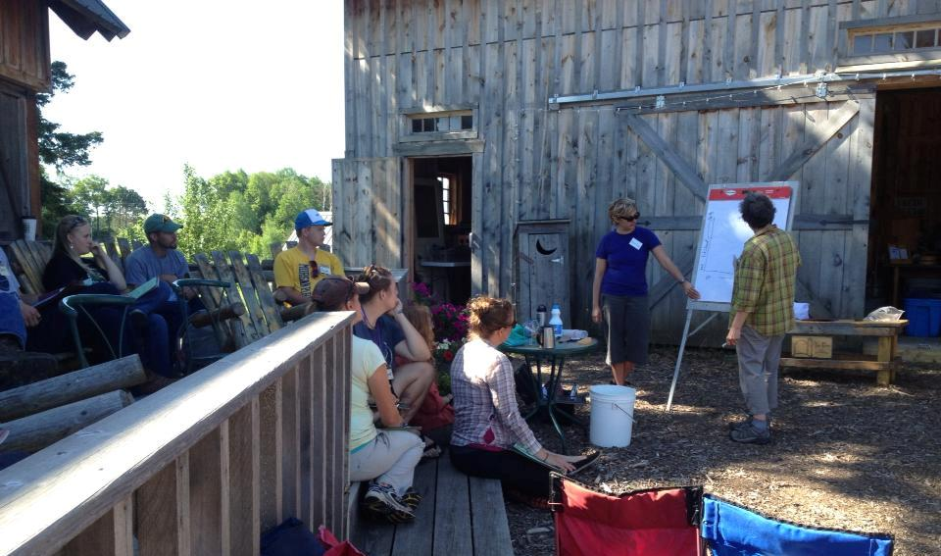


Our Mission
Rooting Opportunity Summit
June 1-2, 2015
Washington DC
Arlene Jones, SPROUT MN Founder, Manager
Cheryal Lee Hills, Executive Director; R5DC
Notes:
A&C – introduce ourselves
Allocate to 25 minutes total
1 What is your organization – and your role in it? .5 minute

Slide 2
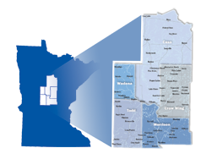
Region Five – central MN
163,000 in 5 counties.
In & Out migration.
10-14% food insecure
9% unemployment
5 unhealthiest counties in state.
Agriculture & Tourism economic drivers.
Resilient Region culture of collaboration
Notes:
CHERYAL
2 What geographic region is the focus area for this story? .5 minute
3 What three‐five key facts do you want participants to know about the region in order to understand the context for your story? For example, these might be related to:
The historic and/or current primary economic/industry base that drives your economy
The demographics and culture of the region
Recent change trends in the economy, culture or demographics that have relevance to the story.
Situational conditions that have placed or kept your low‐income population, firms or places in poverty or near‐poverty. Other critical factors at the outset that came into play in the story, e.g., existing enmities or divides, history of collaboration or non‐collaboration. 1‐2 minutes
________________________________________
WHERE & Who are WE?
Out migration and IN migration.
Region 5 is the only region in the state of Minnesota where all 5 counties are classified as economically distressed
Determined by unemployment and per capita income levels.
Ironically, 4 of our counties were in the bottom 10 of county health care rankings and 3 of our counties are top producers of produce commodities in a 3 state area.
Our challenges were some of our opportunities.
5 counties, 163,000 population​
​65 Cities, mostly all under 500 residents​
​155 Townships, 1 Tribe, 1 Army Camp​. 9,000 miles of road​
1 regional airport, 2 Community Colleges​
​Largest city; Baxter one of top 20 fastest growing Micropolitan’s in the nation
Economic Engines; Ag, precision man, tourism
Between 10-14% of the population in Cass, Morrison, Todd, and Wadena Counties at any given time is food insecure.

Slide 3
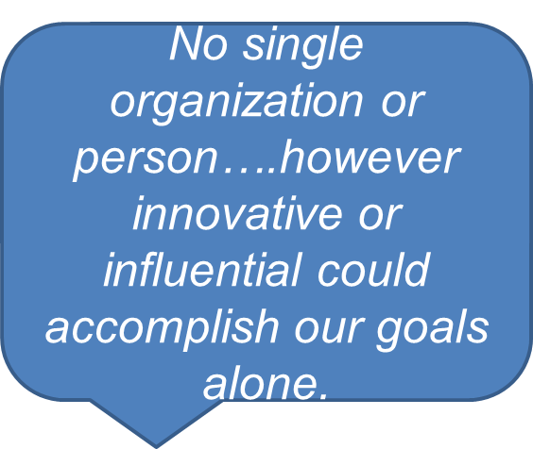
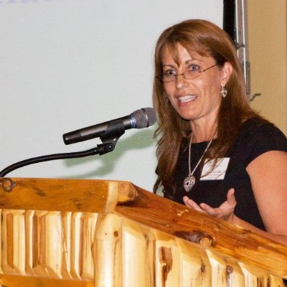
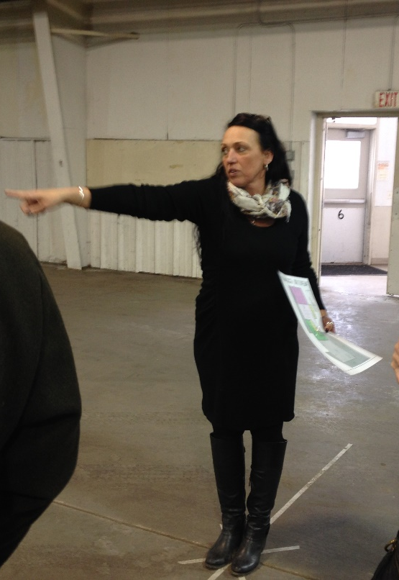
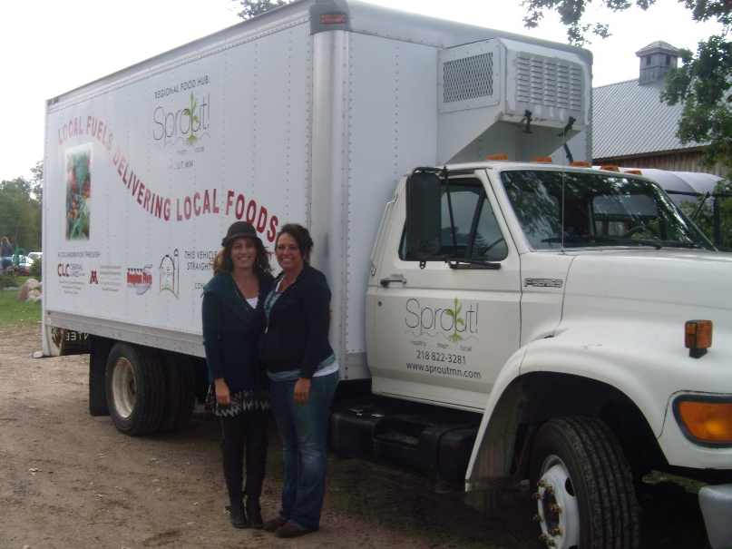
Primary Intermediaries
Beyond hard work…..
Beyond great joy.
Notes:
ARLENE & CHERYAL
4 Who is/are the primary intermediary/intermediaries in the story – the “glue” or backbone organization(s) who assembled and coordinated the pieces for action?
Hint: You or your organization might well be the intermediary! 1 minute
5 When did this effort get started? What are the two or three “tipping” factors that catalyzed the intermediary – or whoever started the effort, if it was someone other than the current coordinator – to do something?
In most cases, the stories being told at this conference represent situations in which organizations have moved beyond traditional roles to do this economic development work in this way. What top three factors most influenced making the move in this direction? 2 minutes
CHERYAL
Local Food sector is an obvious Eco. Dev. opportunity in Ag communities.
Progressing local foods honored our/my regional values of economic prosperity, environmental stewardship and QofL
ARLENE
Understanding the whole system
Passion/support – we had each other
FOR BOTH
We understood need/demand & capacity/supply

Slide 4
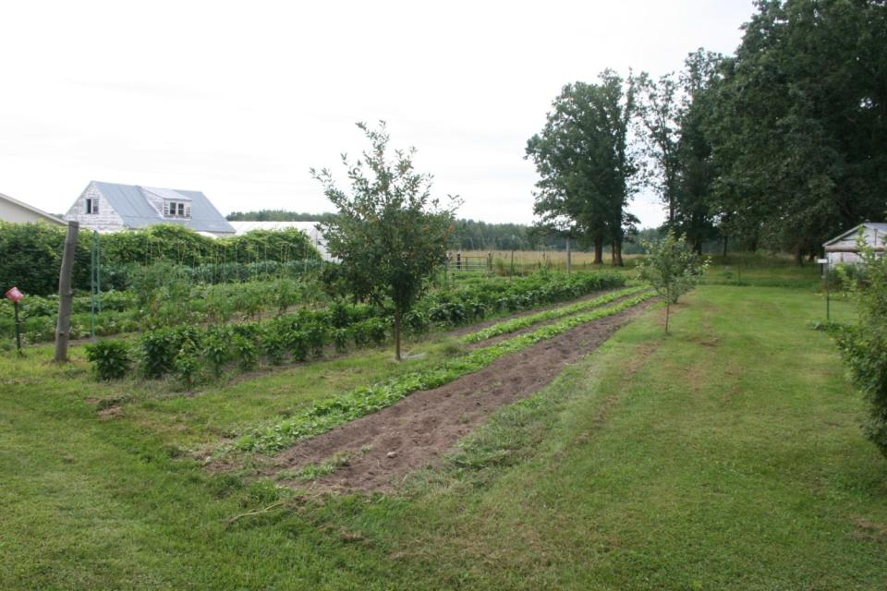
SPROUT Local Food value chain.
Achieving multiple forms of Wealth in Central Minnesota
Arlene coordination of multiple food hubs in north central MN
“WE”
CAN have it all…….it’s what “we” do.
Notes:
CHERYAL
6 What market opportunity and/or sector were targeted with this effort?
First, simply name it (or them): Our local food sector;
Second, tell us what analysis or factors caused you to choose this particular sector or market opportunity as a “wealth‐building” focus for your action. 1 minute
_________________________________
we are replicating the layered mutual-benefit to other projects/programs within our local food value chain and through all of our Resilient Region implementation
EVERY project within our SPROUT food hub value chain builds multiple forms of wealth AND
The WW model is really only two degrees away from our Sustainable Community work – the Resilient Region – it’s how we were already working and three degrees from placemaking by honoring our intent to provide quality of life for all
From an economic development perspective, local foods is economics, and our region has embraced development of a local foods value chain.

Slide 5

SPROUT MN, Building a Resilient Region through the value chain of local foods
Central Minnesota’s Regional Rural Food Hub
Notes:
ARLENE
7 What did you learn about demand for the product(s) or service(s) that your region might provide through this market opportunity or sector?
Someone has to be willing to buy or use a product or service in order for your economic development effort to succeed. You have to learn concrete things about who has demand for it, and what they are looking for in the product or service. So…
What specific steps did you (and/or your partners) take to “talk to demand” – that is, to get useful insight and information from customers who might actually buy or use products or services generated through your targeted market opportunity or sector? What research did you do beforehand to really understand them? What kind of meetings, exchanges or information gathering did you conduct to understand what they were looking for in a quality product or service?
What three or so most important insights emerged from your demand analysis that affected your decision to act and what to do at the outset?
What customers/buyers of the product or service did you determine could serve as “anchor demand” – enough to get you going on producing the product or service in a way that would set you up to satisfy higher volume and/or quality later? 2‐3 minutes
_________________________________________________
We know we have the capacity to produce food in this rural region. Our primary goal is to keep our food, and its economic value, in this rural region.
Wealthworks value chain framework allowed for deeper understanding on engaging value chain partners (U of M Extension, local community college, multiple public health agencies, healthcare institutions, nonprofits, philanthropic organizations) using the core standard of the value proposition. We always consider the value principle, as well – “who else cares about this work and should be at this table?”
Brief SPROUT History
Established 2012
HOW many pounds delivered –over 100,000
45+ growers
5 school districts
Multiple restaurants
2 hospitals
1 college
1 Assisted Living
Numerous food cooperatives
We are very intentional about balancing supply and demand.
We have intentionally focused on the diversity of our growers and expanding market access opportunities – women, latino, amish
SPROUT MN is the most successful FOOD HUB in Minnesota.
a truly a collaborative grassroots effort to build a rural, regional food hub to manage the aggregation and distribution, of locally source-identified food products from our small family farms.
Local Foods has always been part of our natural language in the Resilient Region, and an economic engine. We now use broader language to incorporate WW:
Build and maintain small, rural family farms – keep agricultural land in agricultural production – Natural Capital
Keeping our food dollars local – Financial Capital – local wealth that sticks
Continuing to protect our environment by engaging in sustainable farming practices -
Really focusing on employing communities to “know your farmer” and to tell the story – Social Capital
Engage and encourage healthy outcomes for our rural citizens – Individual Capital
Engaging the entire region as community partners in helping to do the work – Intellectual Capital
Engaging our elected officials in the P&Z work, in the Design Party (Morrison County) and in the meetings with Senator Klobuchar.
The Food Hub is built capital – and its capacity to continue to build multiple forms of wealth continues to reveal itself. The Design Party is a perfect example of created opportunity to engage, deploy the value proposition, and our value principles.

Slide 6





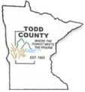



Partnerships – value propositions
The goal of Hunger-Free Minnesota is to increase the number of meals available to food-insecure Minnesotans.
Dr. prescribed CSA’s over 50 families w/pre & post health screenings
CSA’s provided by over 50 LI minority growers
Public Health, hospital nutritionists, Extension nutrition education.
Chef cooking demonstrations
Weekly referral services
Equity and prejudice addressed
Cooking utensils and essentials pd by State
Evaluation, storytelling
Sustained by hospitals
Data compiled by Dr. Stacey Stockdill, www.ensearchmn.com for Hunger-Free Minnesota
Notes:
ARLENE – CLH add if nec
8 What action have you taken to construct a “value chain” of partners that are working together to meet demand, close the gaps and build wealth?
First, detail the overall approach and components that have been put together to make something happen. Who are the key partners, and what are their roles? Choose Health is ONE thing that “happened”
What were the gaps – in know‐how, financing, skills, materials, infrastructure, whatever – that had to be addressed in order to organize to meet demand? Connection of the food hub to personal/public health
How have those gaps been addressed – by partners inside or outside the region? Through Choose Health
Who has coordinated the effort – and what has the coordinator had to do to keep things moving, connected and on the path forward? How has the coordinator’s time been covered? 5‐10 minutes See partners listed
_____________________________________________
Add to the bullets above:
Social Capital: pick up at farmers market, market bucks
“Access” is the gap
Agencies covered coordination through Distributed Leadership Model
IT’S A UNIQUE PARTNERSHIP THAT HITS SEVERAL SWEET SPOTS – Started with a CORE TEAM with an intentional layer focus.
Each partner had an intentional important role!!!
TOGETHER WE: PLAN – DO – LEARN – ADJUST
Pre & Post screenings & surveys
CSA’s from SPROUT 40+ growers AT the local farmers market
Consideration to prejudice and equity
Nutrition education classes
Chef cooking demonstrations
SHIP funded other supplies (cooking utensils and pantry items)
High Touch assistance
Replication
Program evaluation
Program sharing – nationally (Oregon, Kentucky, Ohio, Illinois, Kentucky and more)
Central Minnesota’s Choose Health program is an innovative pilot program that is growing the region’s local food economy and increasing access to healthy options for food-insecure residents through a unique regional partnership, health care system, and food hub. Choose Health is one of several regional initiatives that is growing the region’s local food economy and increasing access to healthy food options for disadvantaged populations.

Slide 7
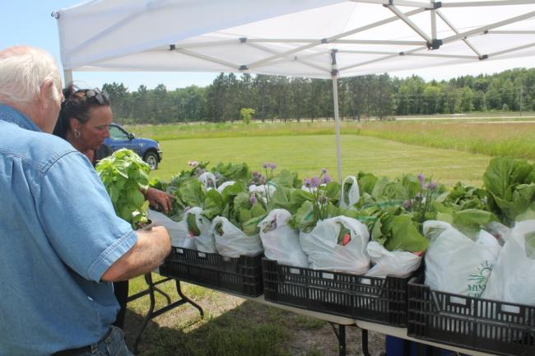
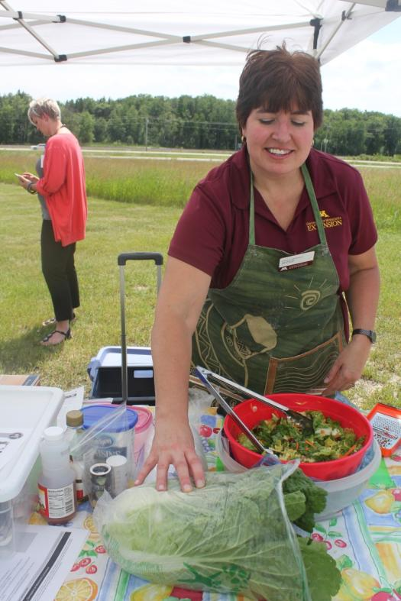
Choose Health = Community Economic Development = Healthy, Resilient Communities
http://www.resilientregion.org/cms/files/Choose%20Health%20Project%20Update%202%20FINAL.pdf
U of M Extension Educator demonstrating an apple romaine salad
The Choose Health Short video https://www.youtube.com/watch?v=EZ72rPKgOAw
Resilient Region – Local Food video
https://www.youtube.com/watch?v=7axBvi1x42I&feature=youtu.be
More on Choose Health
http://www.resilientregion.org/healthcare/
Notes:
Just include – don’t spend any time on this slide

Slide 8
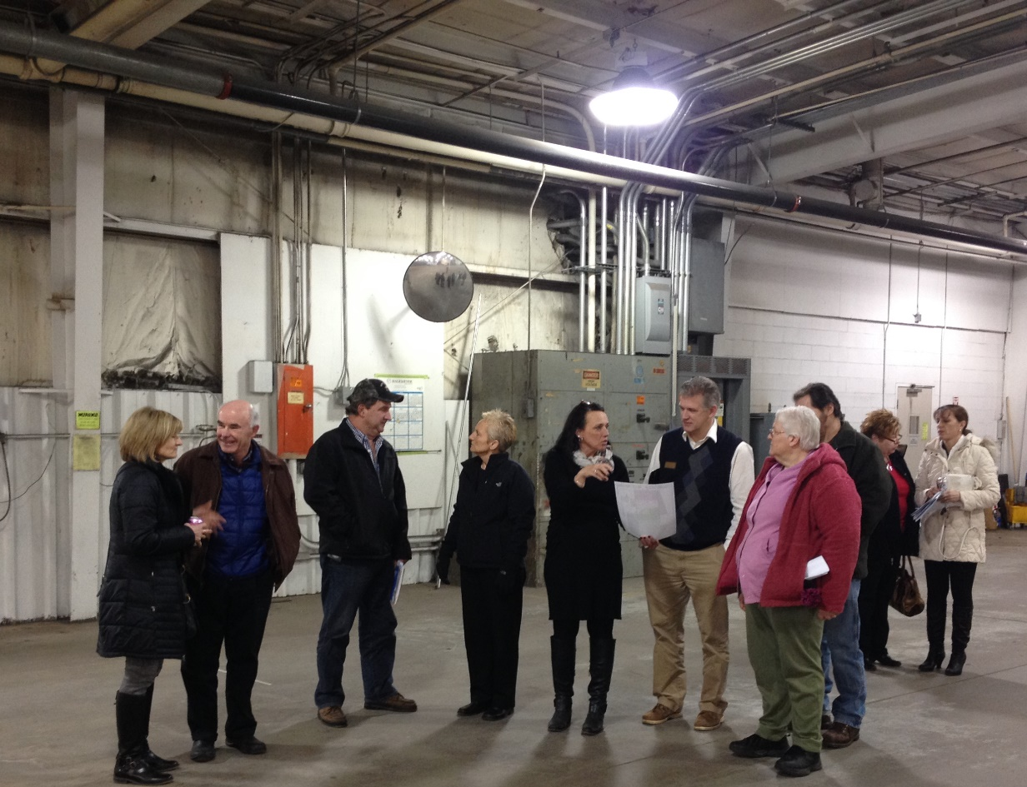
SPROUT Growers & Makers Marketplace……Built & Individual Capitals
This project alone, filling several forms of rural wealth, intense thought to evaluation.
Notes:
ARLENE – CLH below
9 What has happened in your community or regional economy as a result?
People attending are interested in hearing about the wealth‐building results from your effort. Please do your best to document your results with actual facts and figures – and/or reliable projections – on each of these bottom lines.
What forms of capital has it increased (or will it) – in either quantity or quality? Wealth‐building approaches strategically endeavor to build as many of these capitals as possible, while damaging none. Please describe in as specific detail as you can how your effort contributed positively in building any or all these capitals.
Built Capital = Little Falls MarketPlace Facility – underutilized assets
Aggregation
Processing facility
Demonstration kitchen
Marketplace
sentence to serve
Placemaking ties – DESIGN PARTY
Rural MN CEP, DEED and SBDC all there to help with business TA to GROWERS AND ARTISTS
As producers/entrepreneurs adding value to a good or service connected to market demand, and increasing skill and ability in the process.
As employees of businesses producing goods or services, or of organizations supporting the effort.
As consumers of higher quality/lower‐cost goods or services produced or leveraged by the effort.
As investors, owners or co‐owners, gaining, retaining and building wealth that sticks.
CHERYAL
The Kicker: If you can, draw this contrast: Where do you think these bottom lines would be ABSENT the approach taken in the story? 4‐5 minutes
Don’t spend time on this unless asked:
The work would have been done regardless of WW. What WW did was provide a framework for concentration into capitals we might not have spent as much time on.
Our intuition was leading us down the right paths to all the capitals, WW provided structure and intention to do what we were doing…..only better.
INTUITION = INTENTION
___________________________________________
Use this only if we need to for questions:
Individual Capital:
Sentence to Serve = New Skills and Improved Psychic Energy (giving back to the community in a positive way)
Growers = New Sustainable Ag & marketing skills exhibited. # of growers participating in education (business or growing) Grower education: GAP, Post Harvest Handling, Business
Consumers = Improved Psychic Energy – helping to sustain local growers; Increased Skills in preparing healthy foods
(Choose Health) Food Insecure Families = Improved Psychic Energy, Increased Skills in preparing Healthy Foods; Improved County Health Care rankings, # of people who attend the nutrition/cooking public demonstrations
Natural Capital:
Infill of existing building thereby retaining unimpaired environmental assets (e.g. we didn’t tear up green space/ag land to build a new building, we used an existing one and repurposed it for this new use).
Retaining Ag Land – # Pounds Gleaned – Ag rescue for CACFP AT-Risk and Choose Health CSA’s
Cultural Capital:
Resilient Region Theme Champions:
Move from working in silos to working cross discipline,
Developing new norms - way of operation = inclusive;
Developing new language = sustainability & resiliency etc.
Little Falls MarketPlace:
Safe/fun/honoring gathering place for all cultures
# of people who attend the marketplace
How has it served (or is it serving) to build stronger local ownership, control or influence over those capitals?
How has the overall effort included people, places or firms on the economic margins in your region in the action – and improved their livelihoods?
____________________________________________

Slide 9
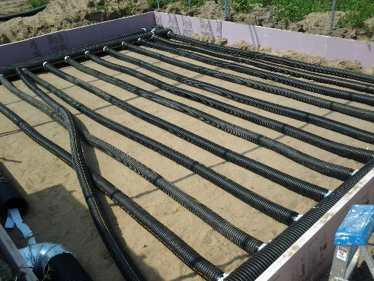
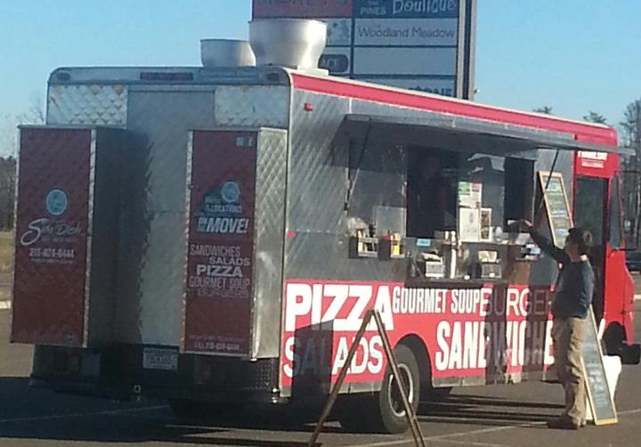
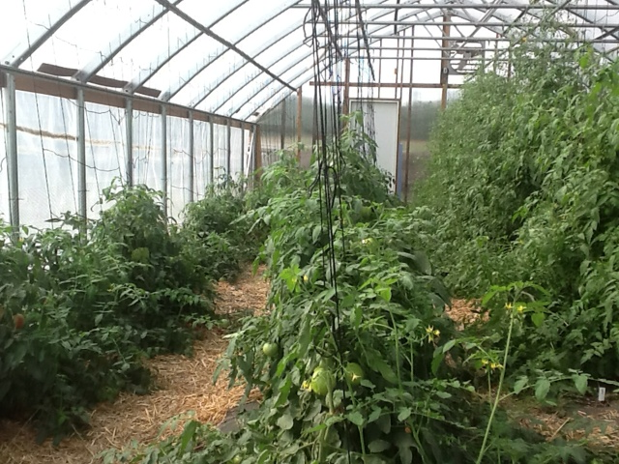
Regional assets utilized differently……….
Solar Thermal High Tunnels from local solar firm: RREAL - to low-income grower farms
Regions ONLY Food Truck - deployed to food deserts – chef cooking demonstrations with nutrition education
Notes:
ARLENE – in 2 seconds go over the projects listed on the slide and discuss partners.
USE THIS TEXT FOR REFERENCE OF QUESTIONS ONLY:
Intellectual Capital = New Spin Off Strategies to build a sustainable community (Choose Health, Connectivity/ecommerce, etc.) How we incorporate our placemaking goals into the Local Foods Value Chain goals (culinary art with mental health). How many changes made to our evaluation process! Biodiesel food truck W/CLC.
Social Capital: Many networks: Resilient Region Champions, Local Foods Partners, Growers, Artist/Grower placemaking consortiums, Food Funders network, MN Food Charter network, # of growers selling through SPROUT food hub (network)- etc.

Slide 10

Financial capital…….
http://regionfive.org/departments/business-financing.html
Microlending with a focus toward ag producers and artisans.
Notes:
CHERYAL
Financial Capital:
Income generated from sale of goods; $ changes in commodity markets, # of markets expanded.
Income generated by growers that can be reinvested into sustainable farm operations
Income generated from the MarketPlace that can be reinvested into sustaining local foods work
Microloans to low-income and minority growers
Access to new capital through “Food Funders Network”
# of Jobs created/retained
WITH SEVERAL PARTNERSHIPS – USDA Rural Microenterprise America Program (RMAP)

Slide 11
Political capital
http://www.extension.umn.edu/rsdp/central/sustainable-agriculture-and-food-systems/local-foods-planning-zoning/?utm_source=RSDP+Happenings+-+Central+March+2015&utm_campaign=RSDP+Template+Test&utm_medium=email
Policy for small family farms- RSDP and CURA CAP
Coordination of multiple food hubs in north central MN
Ag Instructor supported by NJPA – shared by multi-school Districts
Notes:
CHERYAL
WITH SEVERAL PARTNERSHIPS
Political Capital: Ordinances prepared for Local Units of Government,
Consideration of a statewide Food Policy Advisory Group to Governor and State Legislators.

Slide 12

Ag Rescue – Gleaning.
Food security is defined as, “When all people at all times have access to sufficient, safe, nutritious food to maintain a healthy and active life”.
Notes:
CHERYAL
10 What are the next two challenges you are trying to address in your effort? 2 minutes
_________________________________
WHATS NEXT:
Lakewood Food Pharmacy – SNAP, WIC benefits being provided for all 5 counties in one location
Food funders network and crowdfunding
Placemaking efforts that tie to the marketplace and mental health
More wealth being built through our Ag Rescue and Gleaning
VISTA working on - ties to our
CACFP AT-RISK sites (Day cares and after school programs like The SHOP)
Choose Health CSA’s
Local Food shelves

Slide 13
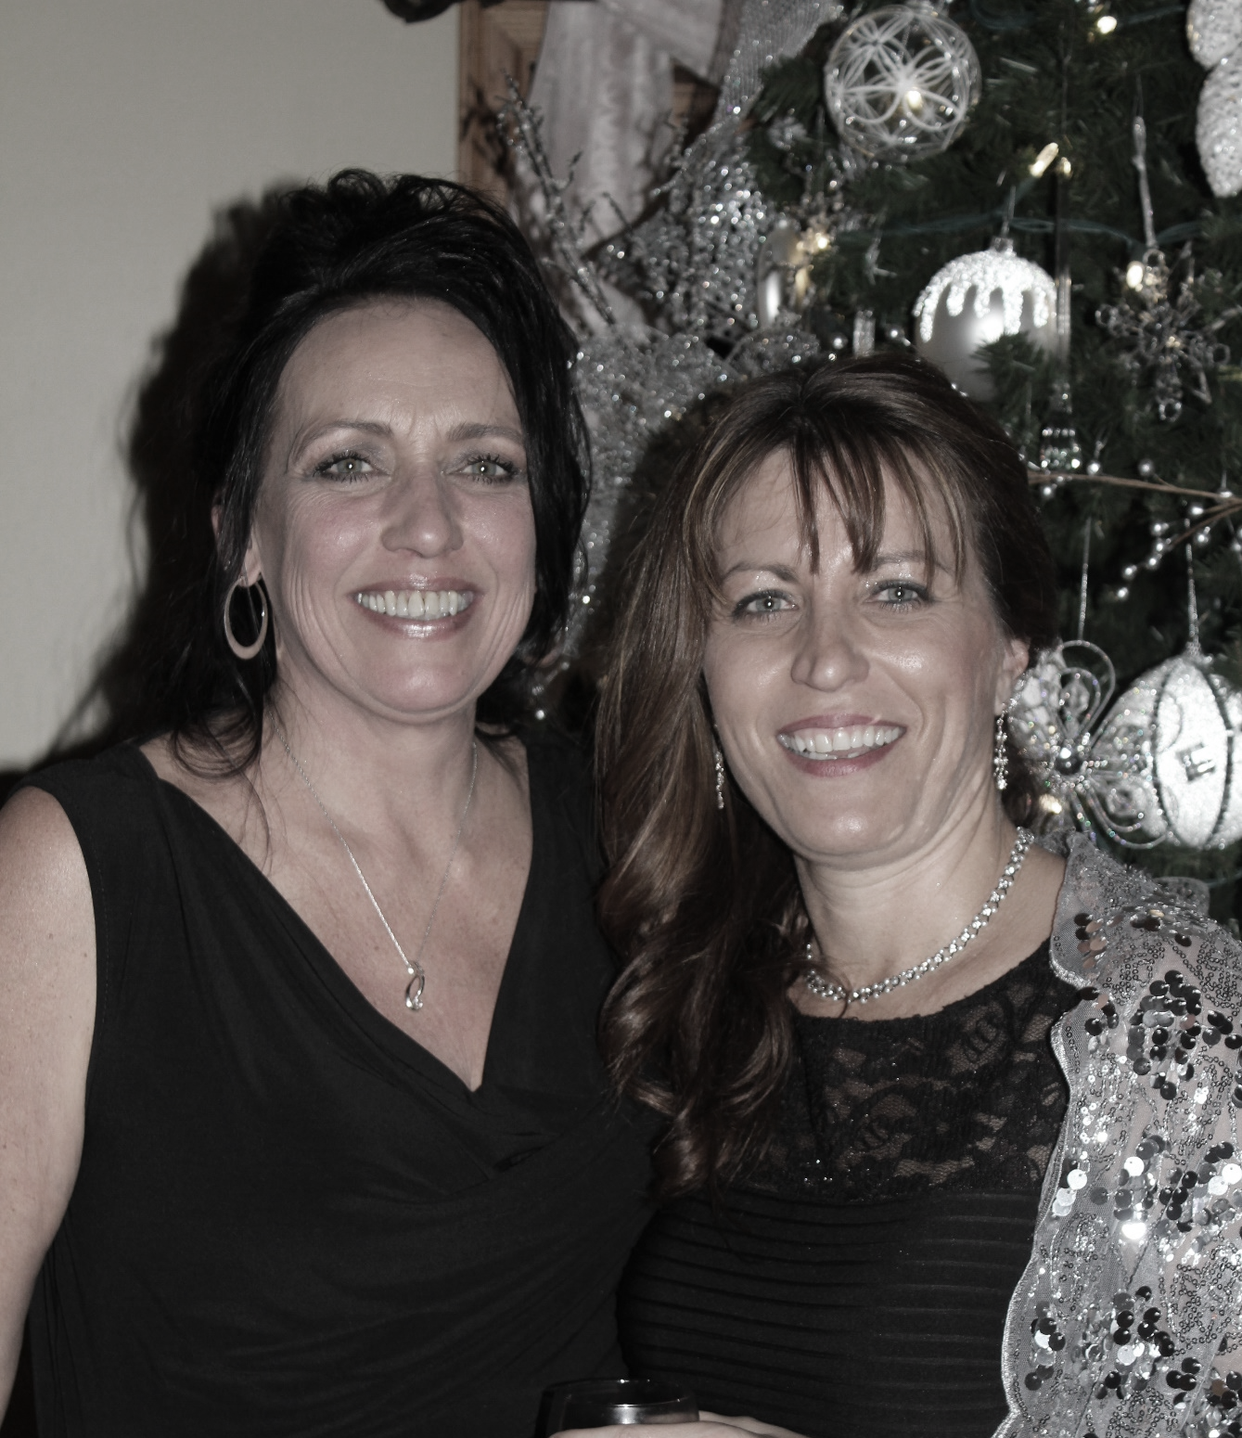
Closing
Do not tempted to take full responsibility for impacting conditions over which I have no direct control.
Trust in the distributed leadership model. Honor your guiding principals.
Being a steadfast subservient leaders has served us well, stay that course.
Notes:
11 If you were starting all over again, what three most savvy pieces of advice would you give yourself?
2 minutes
___________________________
Through a unique relationship between the champions of the Resilient Region project, SPROUT initiatives became a reality through:
Sharing ideas
Bridging the gaps between production and consumption
Building on the momentum of the resilient region project
Utilizing the framework of Wealthworks, to fully appreciate the economic impact of the local foods value-chain
Phasing our growth
Capturing our own story
Replication
Duplication of value chain to other economic development projects within the region and adding value

Slide 14
QUESTIONS?
THANK YOU,
Arlene Jones, SPROUT MN
612.695.2721
sproutmn1@gmail.com
Cheryal Hills, Region Five Development Commission
218.894.3233
chills@regionfive.org

